Slide 1

Data Mining
represented by:
Aleksandra Petkova - S6222041
Nour Aldin ALMUBARAK- p4302185
Victor Essien

Slide 2
Datasets
Online Retail: time series, transactional data – 8 attributes, 541K records
Each row represents a whole sale purchase of an item along with details about the purchase such as: the invoice ID, stock code, item description, quantity purchased, price per unit, the ID and country of the customer who made the purchase.
Groceries: customer recite data – 9K records
# More details here
MovieLens: movie rating data – 100K records
# More details here
Notes:
Add notes

Slide 3
Techniques
Association Rules Mining, Apriori – Aleksandra Petkova, Nour Aldin Almubarak
Algorithm
Questions
Results
Collaborative Filtering – Victor Essien, Nour Aldin Almubarak
Algorithm
Questions
Results
Notes:
Add notes

Slide 4
Algorithm
Apriori Algorithm is one of many algorithms for Association Rules Mining, other popular examples are the Eclat Algorithm, OPUS Search and FP-growth algorithm. We chose to work with Apriori because it is a standard and simple method for association rules mining and is also the one we are most familiar with.
- Online Retail – Used for both the algorithm written from scratch and the algorithm written with the MLextend Library.
- Groceries – Much smaller dataset, no cleaning required, very simple to work with when building an Association Rules Mining algorithm.
Notes:
Add notes

Slide 5
Questions
How many unique items are there?
Which items are very often bought together
Are there any associations in the dataset/s with high confidence?
How many association rules have high confidence?

Slide 6
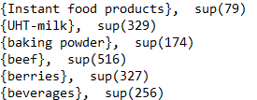
Results
Rules
Frequent Itemsets

Slide 7
Algorithm
Collaborative Filtering (Library) – Victor Essien, Nour Aldin Almubarak
Surprise algorithm has been developed to make recommendation based on Collaborative filtering to predict user rating for a movie, also Nearest neighbour it’s a popular approach; but in this data set we used Surprise algorithm since It has default implementation for a variety of CF algorithms.
- Movielands: This dataset (ml-latest-small) describes 5-star rating a movie recommendation service. It contains 100836 ratings and 3683 tag applications across 9742 movies. These data were created by 610 users between March 29, 1996 and September 24, 2018. This dataset was generated on September 26, 2018.Users were selected at random for inclusion. All selected users had rated at least 20 movies. No demographic information is included. Each user is represented by an id, and no other information is provided.

Slide 8
Questions
find the average rating and number of ratings for the movie?
Find the predicted rating?

Slide 9
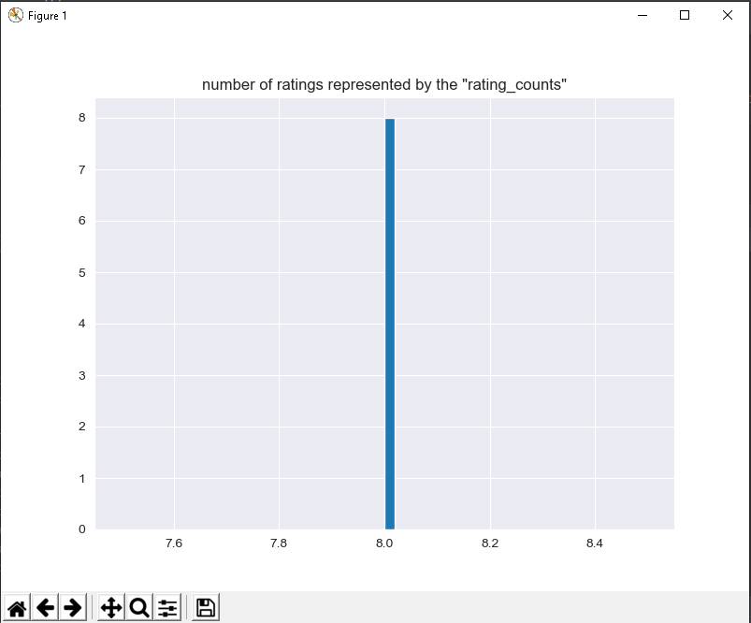
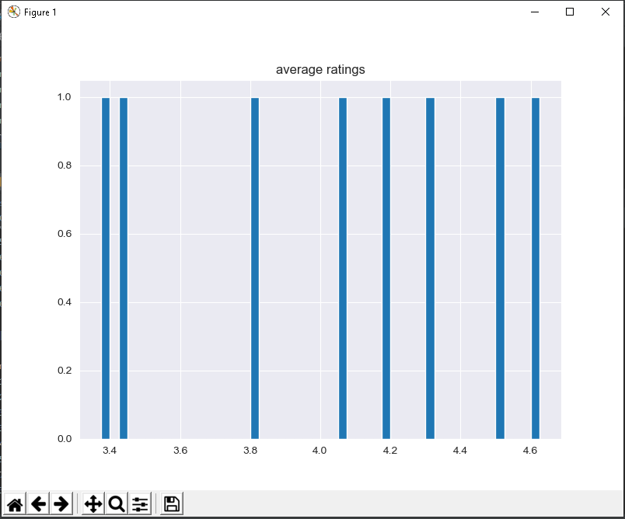
Results
average ratings.
number of ratings represented by the "rating_counts

Slide 10
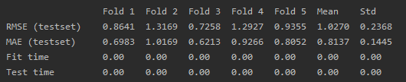
Results
Optimization:
Predicting:

Slide 11
Conclusion
References:

